Slide 1
IO Handling in Java
Mr. M.R.Solanki,
Sr. Lecturer, Information Technology,
SBMP.

Slide 2
Streams
A stream is an abstraction that either produces or consumes information.
A stream is linked to a physical device by the Java I/O system.
All streams behave in the same manner, even if the actual physical devices to which they are linked differ. Thus, the same I/O classes and methods can be applied to any type of device.
An input stream can abstract many different kinds of input: from a disk file, a keyboard, or a network socket.
Likewise, an output stream may refer to the console, a disk file, or a network connection.
Streams are a clean way to deal with input/output without having every part of your code understand the difference between a keyboard and a network.
Java implements streams within class hierarchies defined in the java.io package.

Slide 3
Types of Streams
Java 2 defines two types of streams: byte and character:
Byte streams provide a convenient means for handling input and output of bytes
Byte streams are used, for example, when reading or writing binary data.
Character streams provide a convenient means for handling input and output of characters. They use Unicode and, therefore, can be internationalized.
The character-based streams simply provide a convenient and efficient means for handling characters.

Slide 4
Byte Stream Classes
Byte streams are defined by using two class hierarchies.
At the top are two abstract classes: InputStream and OutputStream.
Each of these abstract classes has several concrete subclasses the examples are : BufferedInputStream, BufferedOutputStream, FileInputStream, FileOutputStream, etc.
To use the stream classes, you must import java.io
The abstract classes InputStream and OutputStream define several key methods that the other stream classes implement.
Two of the most important are read() and write(), which, respectively, read and write bytes of data.

Slide 5
Character Stream Classes
Character streams are defined by using two class hierarchies.
At the top are two abstract classes, Reader and Writer.These abstract classes handle Unicode character streams.
Java has several concrete subclasses of each of these. The examples are: BufferedReader, BufferedWriter, FileReader, FileWriter, etc.
The abstract classes Reader and Writer define several key methods that the other stream classes implement. Two of the most important methods are read() and write() , which read and write characters of data, respectively. These methods are overridden by derived stream classes.

Slide 6
Reading Console Input in Java
Java does not have a generalized console input method like standard C function scanf( ) or C++ input operators cin.
In Java, console input is accomplished by reading from System.in.
To obtain a character-based stream that is attached to the console, you wrap System.in in a BufferedReader object, to create a character stream.
BuffereredReader supports a buffered input stream. Its most commonly used constructor is shown here:
BufferedReader(Reader inputReader)
Here, inputReader is the stream that is linked to the instance of BufferedReader that is being created.

Slide 7
Reading Console Input in Java
Reader is an abstract class. One of its concrete subclasses is InputStreamReader, which converts bytes to characters.
To obtain an InputStreamReader object that is linked to System.in, use the following constructor:
InputStreamReader(InputStream inputStream)
Because System.in refers to an object of type InputStream, it can be used for inputStream.
Putting it all together, the following line of code creates a BufferedReader that is connected to the keyboard:
BufferedReader br = new BufferedReader(new InputStreamReader(System.in));
After this statement executes, br is a character-based stream that is linked to the console through System.in.

Slide 8
Reading Console Input in Java
Reading Characters:
To read a character from a BufferedReader, use read( ). The version of read( ) that we will be using is
int read( ) throws IOException
Each time that read( ) is called, it reads a character from the input stream and returns it as an integer value. It returns –1 when the end of the stream is encountered. It can throw an IOException.

Slide 9
Reading Console Input in Java
Reading Characters:
import java.io.*;
class BRRead {
public static void main(String args[]) throws IOException
{
char c;
BufferedReader br = new BufferedReader(new InputStreamReader(System.in));
System.out.println("Enter characters, 'q' to quit.");
// read characters
do {
c = (char) br.read();
System.out.println(c);
} while(c != 'q');
}
}

Slide 10
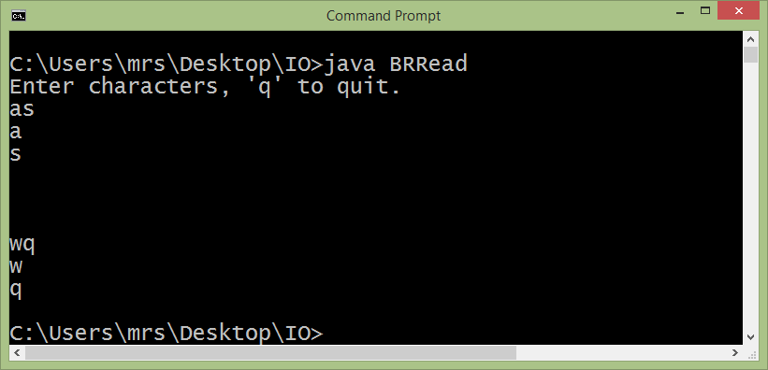
Reading Console Input in Java

Slide 11
Reading Console Input in Java
Reading Strings:
To read a string from the keyboard, use the version of readLine( ) that is a member of the BufferedReader class. Its general form is shown here:
String readLine( ) throws IOException
As you can see, it returns a String object. It can throw an IOException.

Slide 12
Reading Console Input in Java
Reading Strings:
import java.io.*;
class BRReadLines {
public static void main(String args[]) throws IOException
{
// create a BufferedReader using System.in
BufferedReader br = new BufferedReader(new
InputStreamReader(System.in));
String str;
System.out.println("Enter lines of text.");
System.out.println("Enter 'stop' to quit.");
do {
str = br.readLine();
System.out.println(str);
} while(!str.equals("stop"));
} }

Slide 13
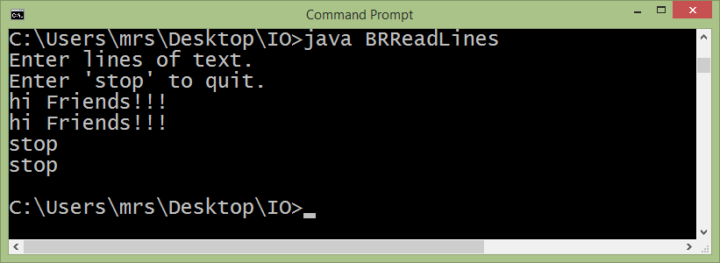
Reading Console Input in Java

Slide 14
File Handling in Java
File:
File class does not operate on streams.
It deals directly with files and the file system
A File object is used to obtain or manipulate the information associated with a disk file, such as the permissions, time, date, and directory path, and to navigate subdirectory hierarchies. File(String directoryPath)
File(String directoryPath)
File(String directoryPath, String filename)
File(File dirObj, String filename)
File(URI uriObj)
Here, directoryPath is the path name of the file, filename is the name of the file, dirObj is a File object that specifies a directory, and uriObj is a URI object that describes a file.

Slide 15
File Handling in Java
File:
The following example creates three files: f1, f2, and f3.
The first File object is constructed with a directory path as the only argument.
The second includes two arguments—the path and the filename.
The third includes the file path assigned to f1 and a filename; f3 refers to the same file as f2.
File f1 = new File("/");
File f2 = new File("/","autoexec.bat");
File f3 = new File(f1,"autoexec.bat");

Slide 16
File Handling in Java
File:
File defines many methods that obtain the standard properties of a File object.
getName( ) returns the name of the file
getParent( ) returns the name of the parent directory,
exists( ) returns true if the file exists, false if it does not.
There are many methods that allow you to examine the properties of a simple file object, but no corresponding function exists to change those attributes.

Slide 17
File Handling in Java
File:
import java.io.File;
class FileDemo {
static void p(String s) {
System.out.println(s);
}
public static void main(String args[]) {
File f1 = new File("C:\\Users\\mrs\\Desktop\\IO\\javaio\\strem1.txt");
p("File Name: " + f1.getName());
p("Path: " + f1.getPath());
p("Abs Path: " + f1.getAbsolutePath());
p("Parent: " + f1.getParent());
p(f1.exists() ? "exists" : "does not exist");
p(f1.canWrite() ? "is writeable" : "is not writeable");
p(f1.canRead() ? "is readable" : "is not readable");
p("is " + (f1.isDirectory() ? "" : "not" + " a directory"));

Slide 18
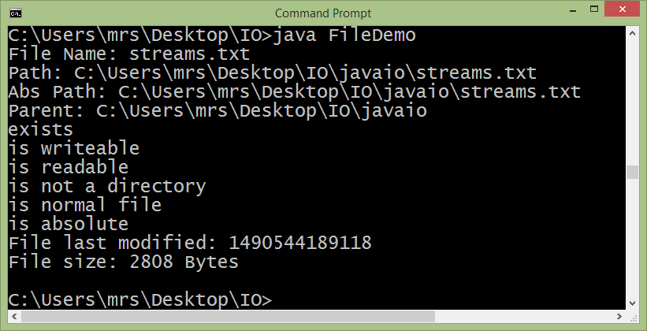
File Handling in Java
File:
p(f1.isFile() ? "is normal file" : "might be a named pipe");
p(f1.isAbsolute() ? "is absolute" : "is not absolute");
p("File last modified: " + f1.lastModified());
p("File size: " + f1.length() + " Bytes");
} }

Slide 19
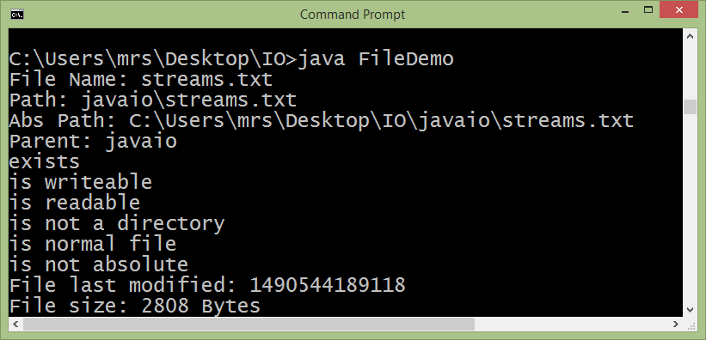
File Handling in Java
File: Relative Path
File f1 = new File("javaio/streams.txt");

Slide 20
File Handling in Java
File:
Method | Description
Boolean renameTo(File newName) | It is used to rename a given file.The filename specified by newName becomes the new name of the invoking File object. It returns true upon success and false if the file cannot be renamed.
boolean delete( ) | Deletes the disk file represented by the path of the invoking File object. Also used to delete a directory if the directory is empty. delete( ) returns true if it deletes the file and false if the file cannot be removed.
void deleteOnExit( ) | Removes the file associated with the invoking object when the Java Virtual Machine terminates.
boolean isHidden( ) | Returns true if the invoking file is hidden. Returns false otherwise.
boolean setLastModified(long millisec) | Sets the time stamp on the invoking file to that specified by millisec, which is the number of milliseconds from January 1, 1970, Coordinated Universal Time (UTC).
boolean setReadOnly( ) | Sets the invoking file to read-only.

Slide 21
File Handling in Java
Directories:
A directory is a File that contains a list of other files and directories.
When you create a File object and it is a directory, the isDirectory( ) method will return true.
In this case, you can call list( ) on that object to extract the list of other files and directories inside.
It has two forms. The first is shown here:
String[ ] list( )
The list of files is returned in an array of String objects.

Slide 22
File Handling in Java
Directories:
import java.io.File;
class DirList {
public static void main(String args[]) {
String dirname = “c:\\iofiles";
File f1 = new File(dirname);
if (f1.isDirectory()) {
System.out.println("Directory of " + dirname);
String s[] = f1.list();
for (int i=0; i < s.length; i++) {
File f = new File(dirname + "/" + s[i]);

Slide 23
File Handling in Java
Directories:
if (f.isDirectory()) {
System.out.println(s[i] + " is a directory");
} else {
System.out.println(s[i] + " is a file");
}
}
} else {
System.out.println(dirname + " is not a directory");
}
}
}

Slide 24
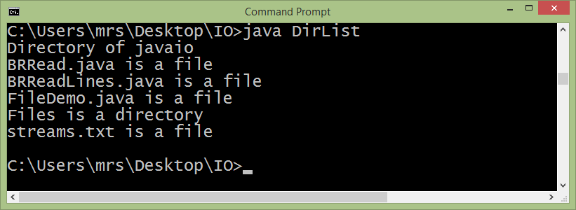
File Handling in Java

Slide 25
Reading File Content using Byte Stream classes
import java.io.*;
class FileInputStreamDemo {
public static void main(String args[]) throws Exception
{
InputStream fin = new FileInputStream(args[0]);
int i;
do {
i = fin.read();
if(i != -1) System.out.print((char) i);
} while(i != -1);
fin.close();
}
}

Slide 26
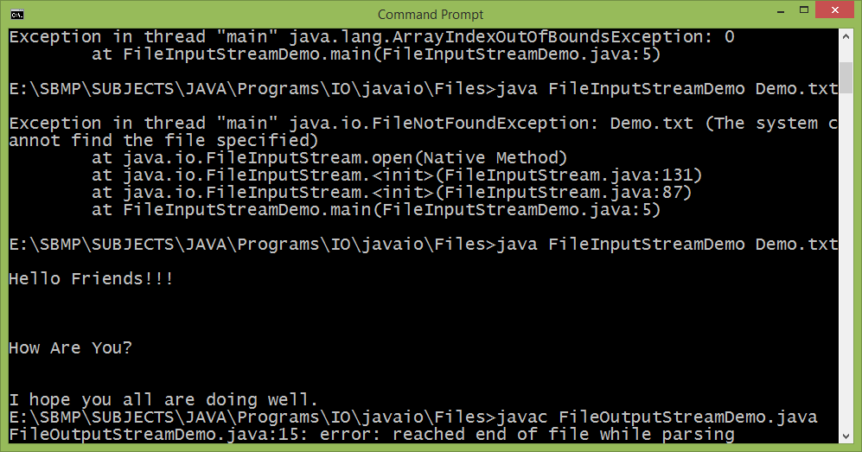
Reading File Content using Byte Stream classes

Slide 27
Writing data to File using Byte Stream classes
import java.io.*;
class FileOutputStreamDemo {
public static void main(String args[]) throws Exception {
String source = "Now is the time for all good men\n"
+ " to come to the aid of their country\n"
+ " and pay their due taxes.";
byte buf[] = source.getBytes();
OutputStream f0 = new FileOutputStream("file1.txt");
for (int i=0; i < buf.length; i += 1) {
f0.write(buf[i]);
}
f0.close();
OutputStream f1 = new FileOutputStream("file2.txt");
f1.write(buf);
f1.close();
}}

Slide 28
Reading File using Character Stream classes
import java.io.*;
class FileReaderCharDemo {
public static void main(String args[]) throws Exception {
FileReader fr = new FileReader(args[0]);
int ch;
while((ch = fr.read()) != -1) {
System.out.print((char)ch);
}
fr.close();
}
}
Output is same as in case of Byte stream class

Slide 29
Writing data to File using Char Stream classes
import java.io.*;
class FileWriterCharStreamDemo {
public static void main(String args[]) throws Exception {
String source = "Now is the time for all good men\n"
+ " to come to the aid of their country\n"
+ " and pay their due taxes.";
char buffer[] = source.toCharArray();
FileWriter f0 = new FileWriter("file1.txt");
for (int i=0; i < buffer.length; i += 1) {
f0.write(buffer[i]);
}
f0.close();
FileWriter f1 = new FileWriter("file2.txt");
f1.write(buffer);
f1.close();
}}

Slide 30
Exercise
Write a Program which reads the contents of one file and writes it to other file. (Copying content of one file to other)

Slide 31
Thank You

